Slide 1
Attendance Management System Project
Under Supervision of :
Dr. Shymaa Esmaiel
Eng. Myada

Slide 2
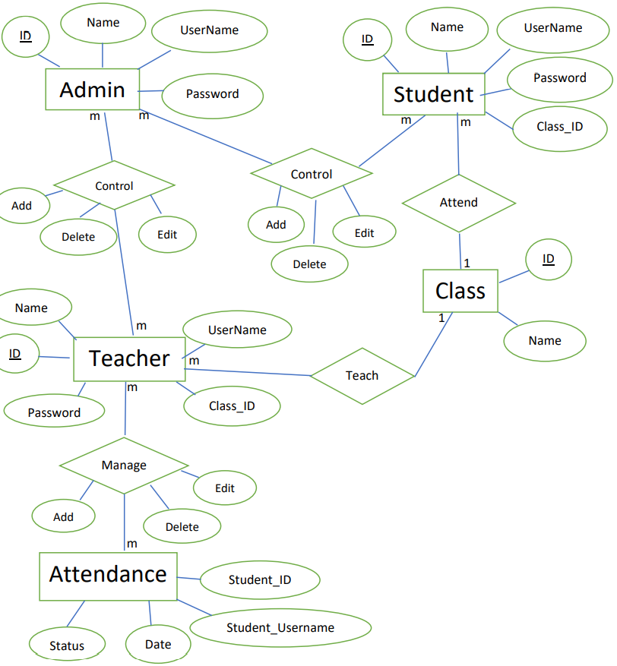
Entities Relationship Diagram (ERD)

Slide 3
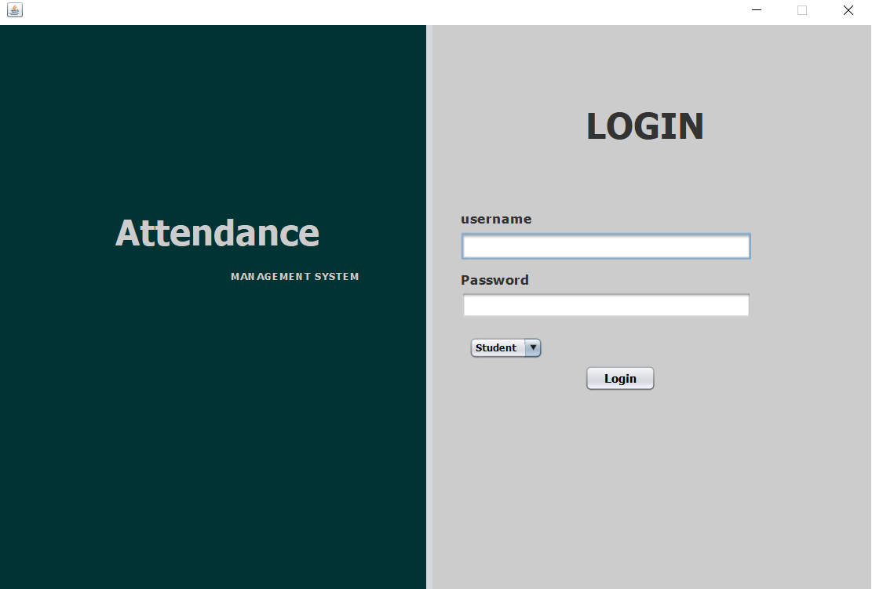
1-LogIn module

Slide 4
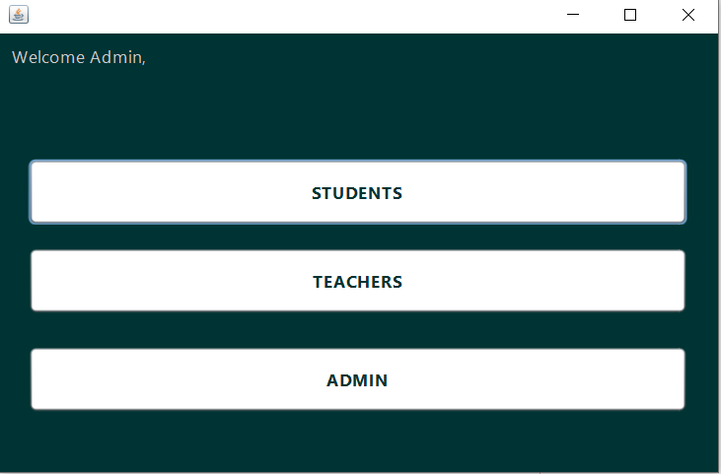
2-Home page for admin

Slide 5
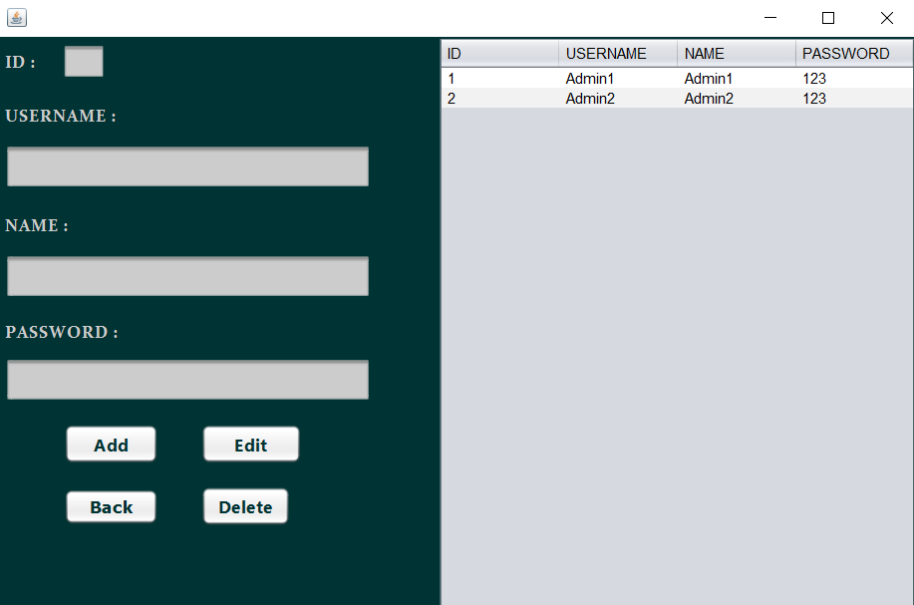
3-Admin user control module

Slide 6
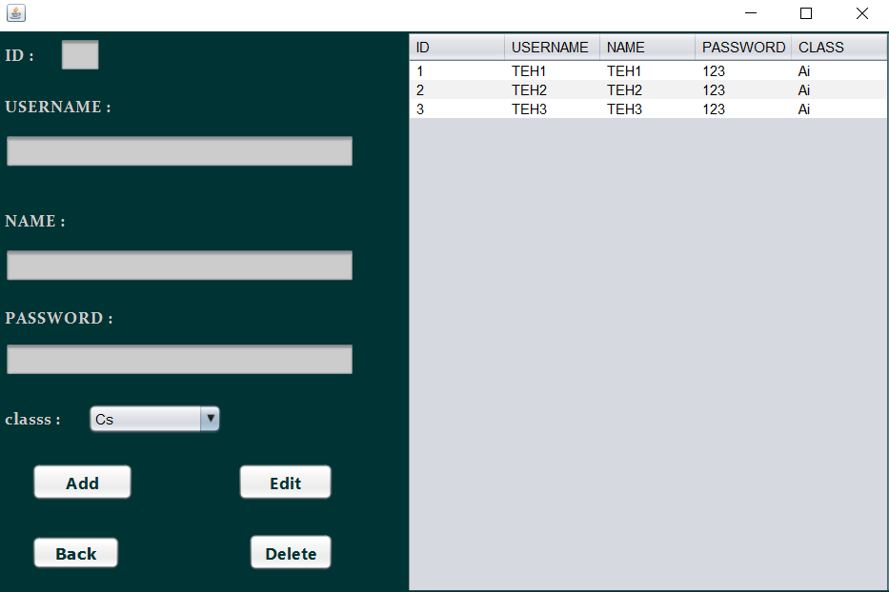
4-Teacher control module

Slide 7
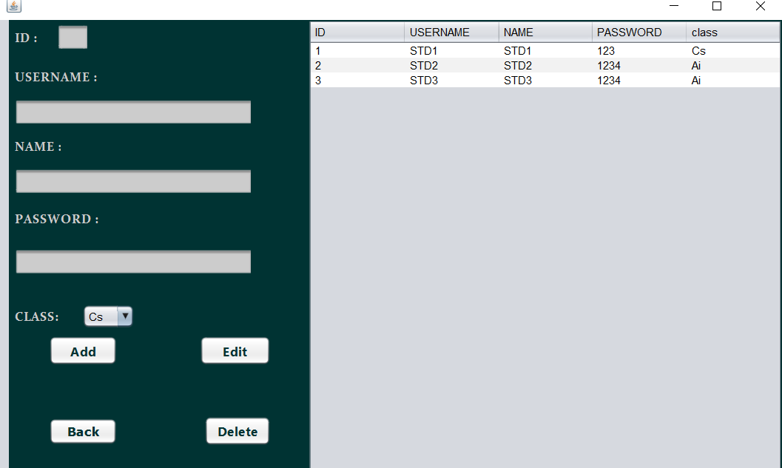
5- Student control module

Slide 8
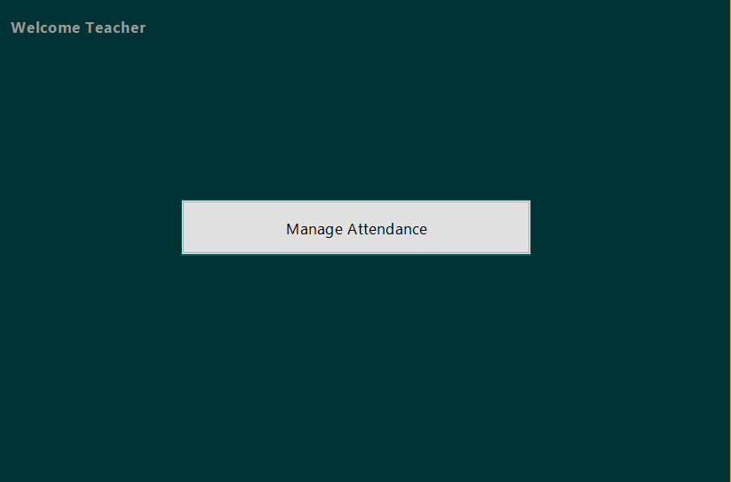
6-Home page for teachers

Slide 9
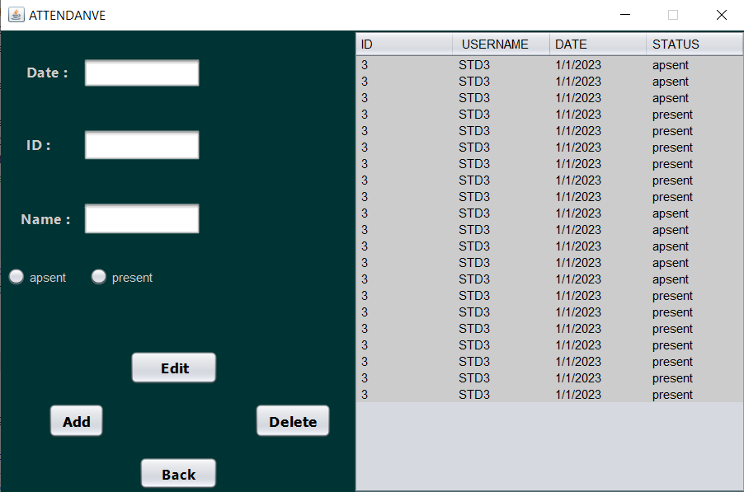
7- Manage attendance

Slide 10
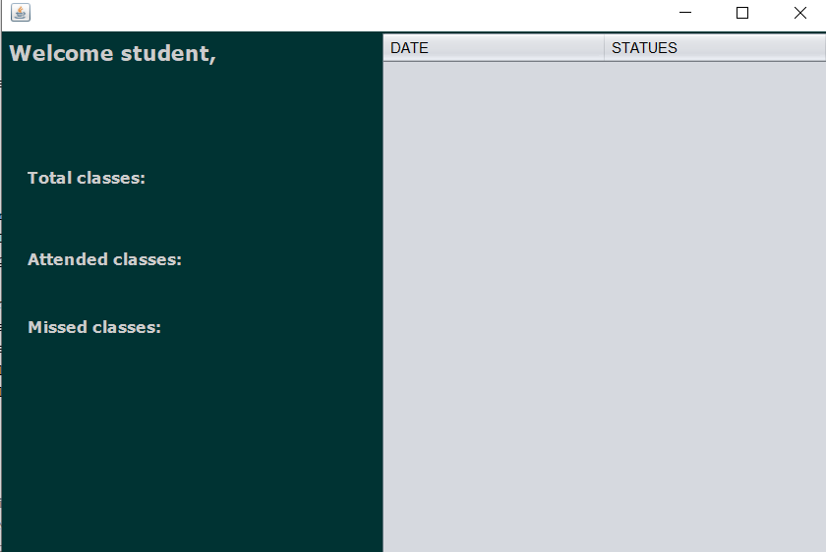
8- Home page for students

Slide 11
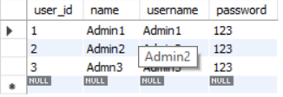
Admin table

Slide 12
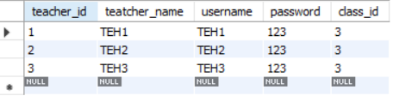
Teacher table

Slide 13
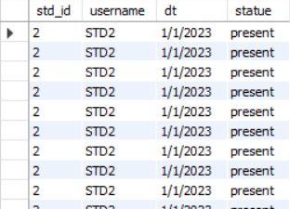
Student table

Slide 14
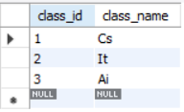
Class table

Slide 15
Team members
1-Habiba Amr Ali
2-Habiba Abdul_Sameei Abdul_Hameed.
3-Aya Yousry Abo_Elabas
4-Heckmat Rda Sameer
5-Toqa Yasser Talat

